Slide 1
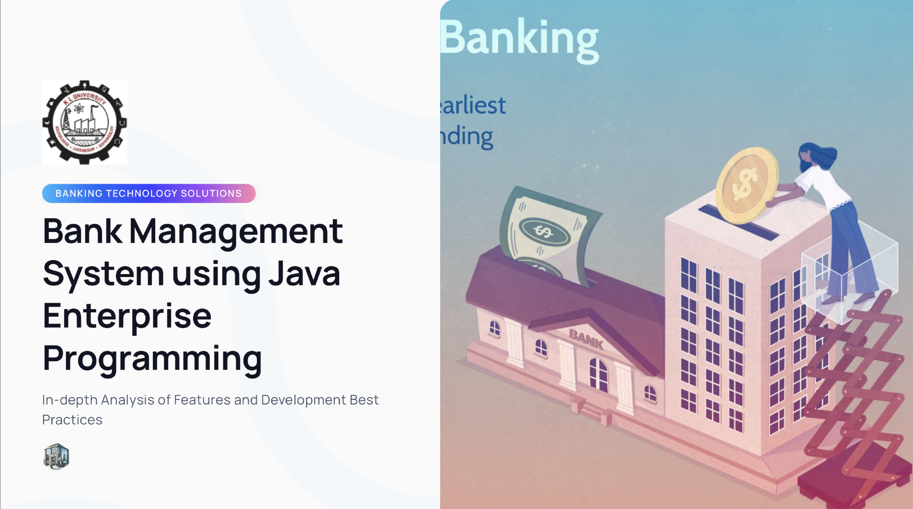
2210030229-Murari
2210030103-Satya
2210030415-Keerthan
2210030409-Sainath

Slide 2
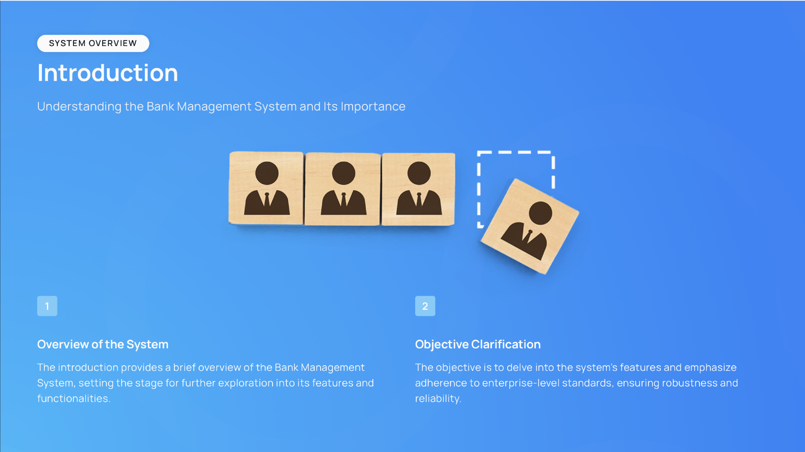

Slide 3



Surveyed Applications:

Slide 4
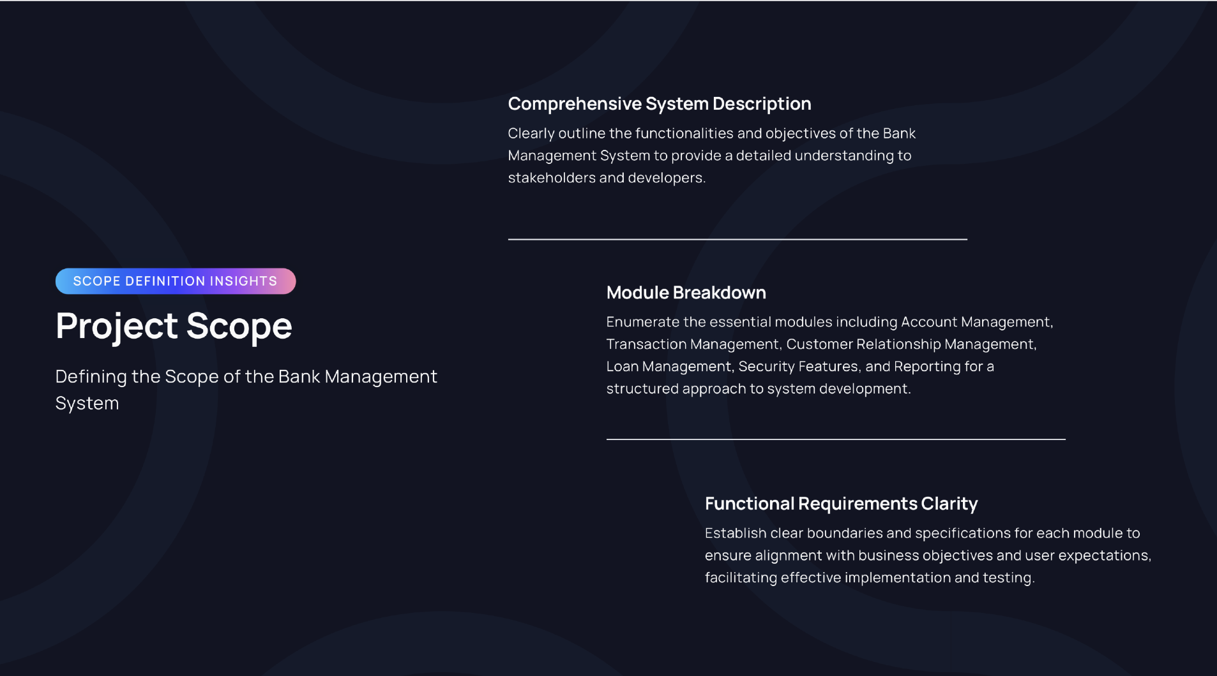

Slide 5
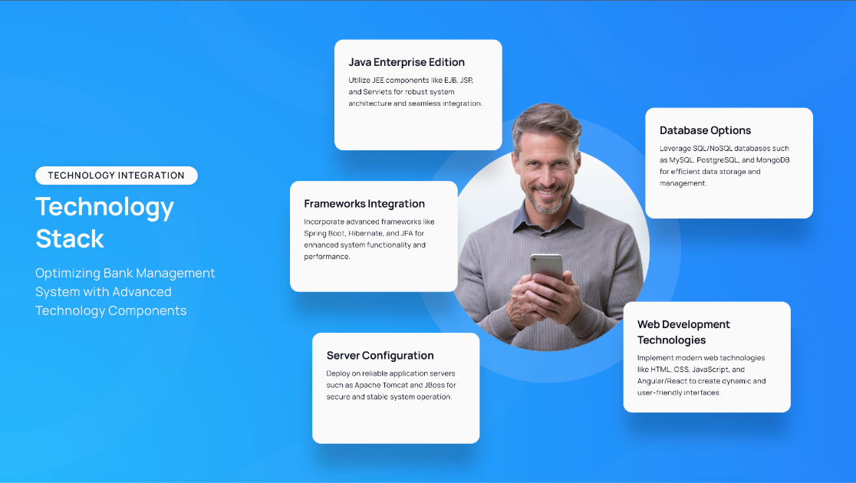

Slide 6
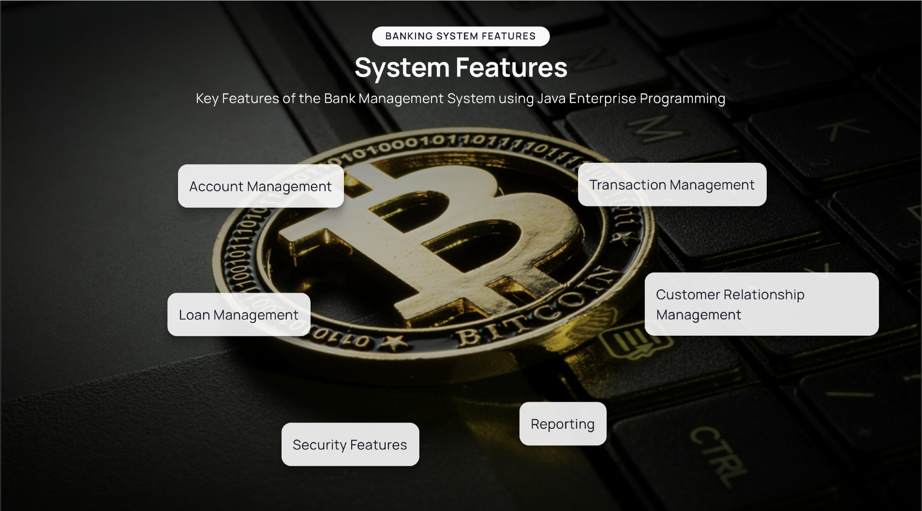

Slide 7
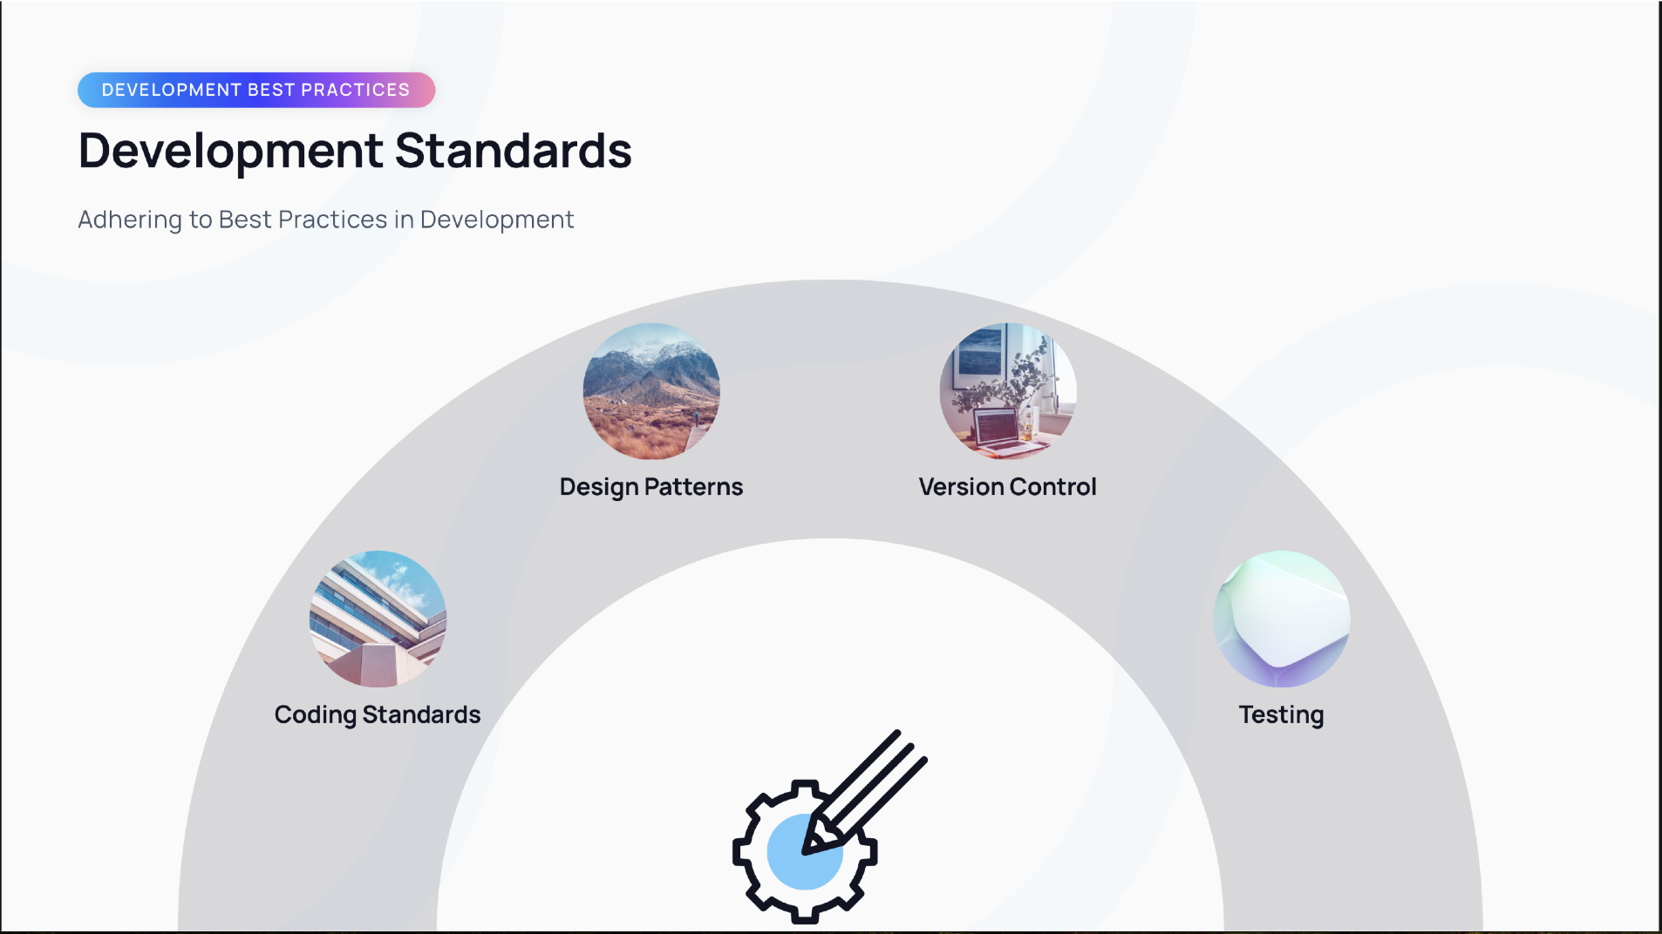

Slide 8
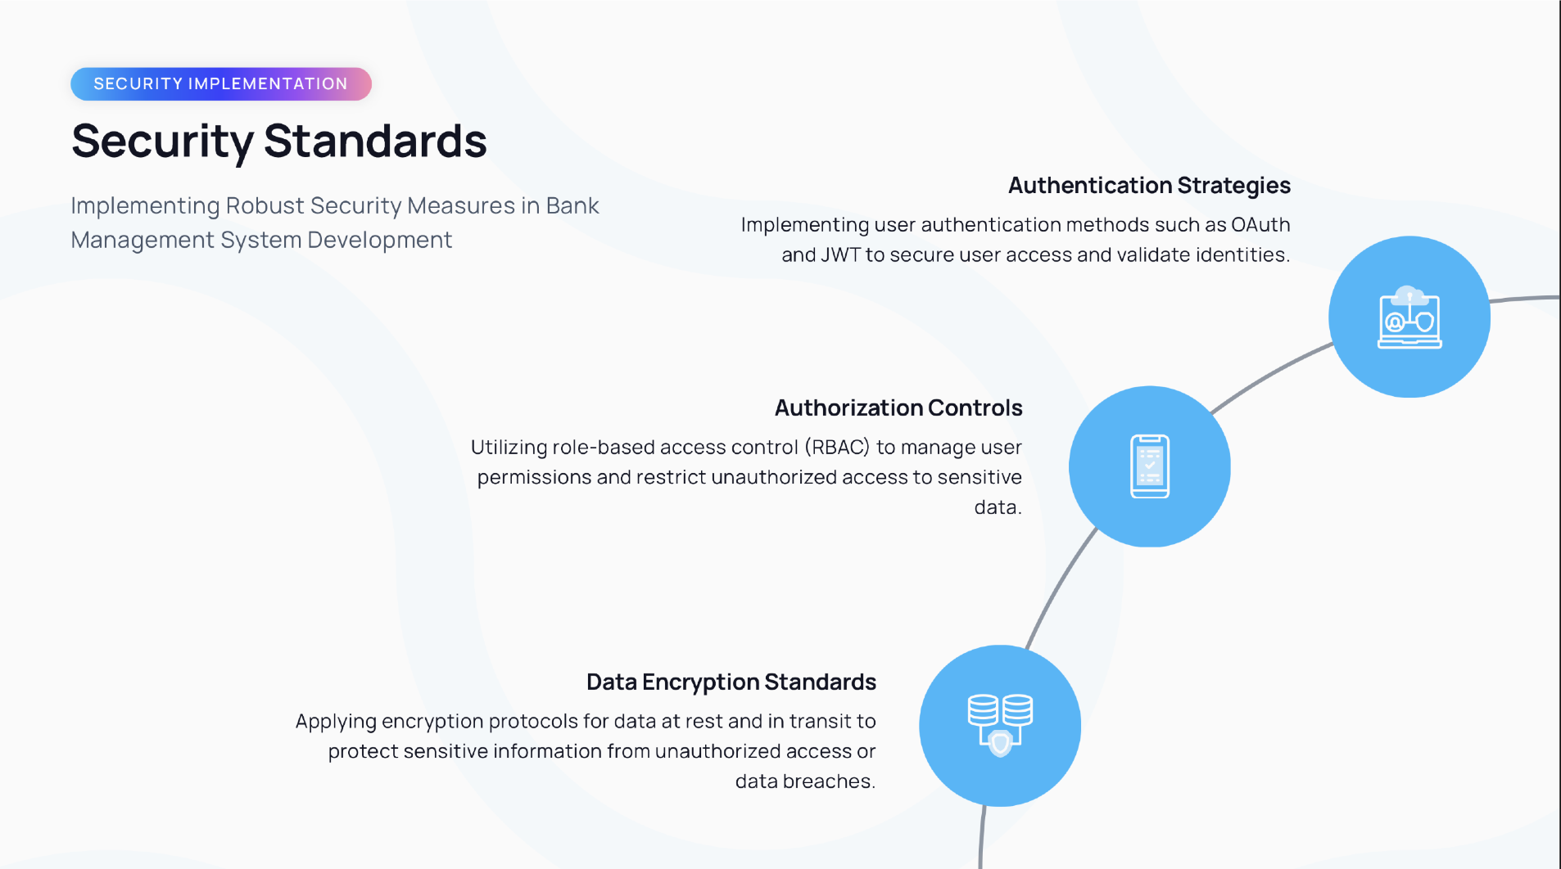
0

Slide 9
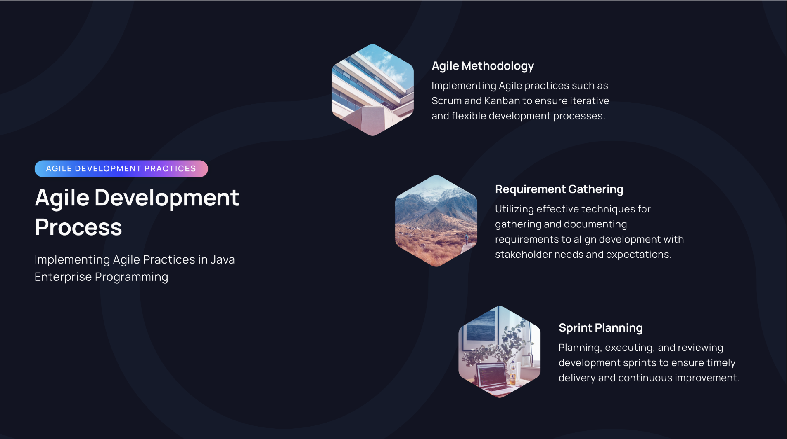

Slide 10
USERS
Customers
Cashier
Manager
Bank

Slide 11
Tables
Customer
Customer Id
Address
Contact
Username
Password
Beneficiary
Beneficiary Id
Bank Details
Name
Account
Account Id
Customer Id
Customer Id
Name
Account Number
Balance
Type

Slide 12
Transaction
Transaction Id
Time Stamp
Type
Account ID
Amount
Loan
Customer ID
Loan Amount
Loan ID
Type
Interest Rate

Slide 13
THANK YOU

